Slide 1
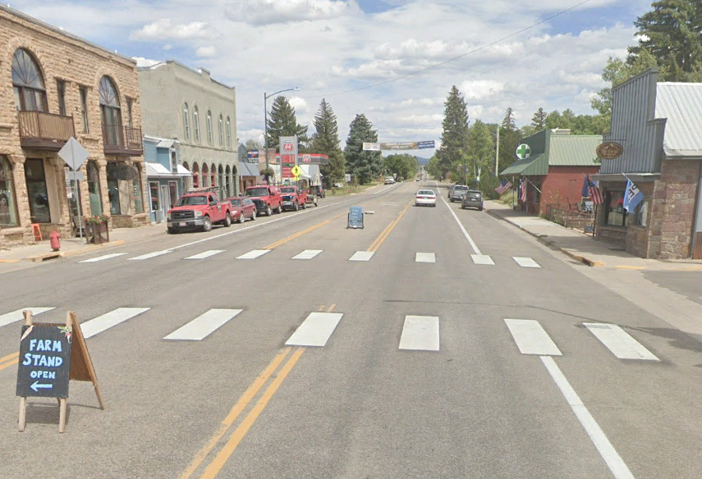

Town of Norwood
Master Drainage Plan
$4.3M in Prioritized Drainage Improvements
David Rothwell – Presenter

Slide 2
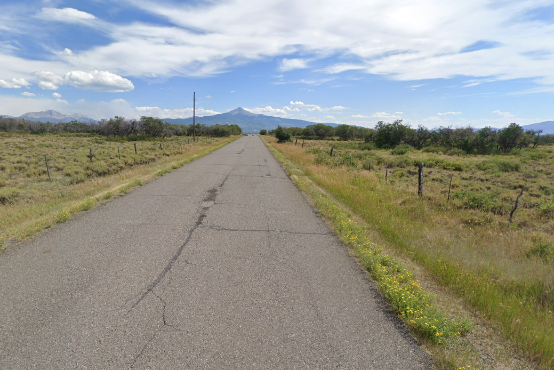
Master Drainage Plan Goals
Inventories the Town's ditches, culverts, and storm pipe
Evaluates capacity against design storm flows
Documents where flooding occurs and why
Develops improvements with planning-level costs
Ranks projects so downstream capacity comes first
Identifies low-cost maintenance for the near term
Addresses co-mingled irrigation and stormwater
Develops new drainage standards for Town
Provides the key information grant programs require
Supports planning and prioritization – Individual projects still need surveyed, utility coordination, and final design
Notes:
The master drainage plan inventories existing town drainage infrastructure, screens components hydraulically, identifies deficiencies, develops high-level improvements and costs, and prioritizes implementation.

Slide 3
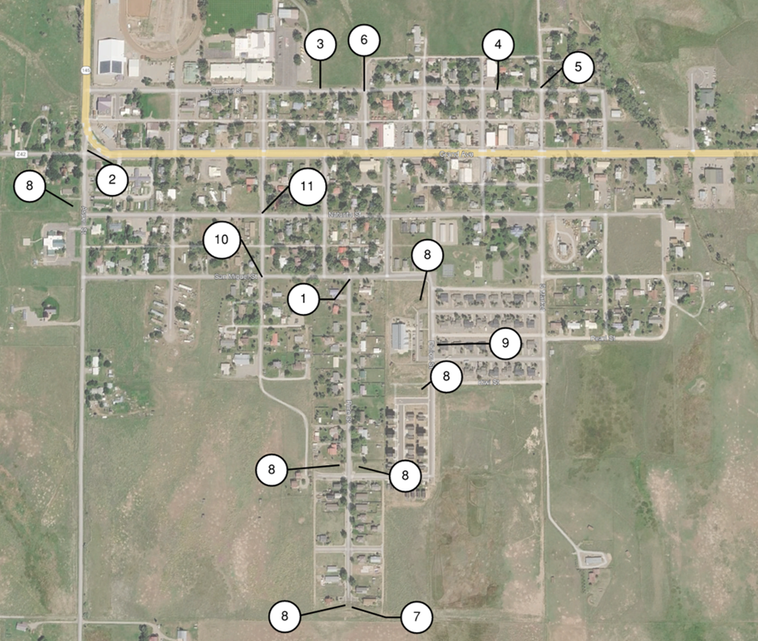
Historic Problem Areas
1. Pine & San Miguel — flooding at homes
2. Aspen & CO Z42 — inlet misses runoff
3. Summit, Cedar to Spruce — 6-in. culvert
4. Summit, Market to Lucerne — floods by Fire Dept.
5. Summit & Market — intersection ponding
6. Cedar N of Grand — pipe bottleneck, backup
7. Homestead basin — outlet control undersized
8. Detention basins — no hardened spillways
9. Pinion at San Miguel/Kiwi — ditch ponding
10. San Miguel & Spruce — culvert backup
11. Naturita & Spruce — culvert backup
Town-wide: irrigation and stormwater co-mingled and ditch improvements
Notes:
Pine Street & San Miguel: This area is problematic as Town staff has expressed concerns over the possibility of flooding residential property located immediately to the north of the intersection. Water has been observed to be within a foot of the roadway crown during heavy rainfall events.
Southeast corner of intersection of Aspen Street and County Road Z42 (Grand): Culvert inlet does not provide adequate interception of water. Frequent flooding has been observed at this location.
South side of Summit Street between Cedar and Spruce Streets: Stormwater drains into a 6-inch irrigation culvert. Ponding has been observed here during heavy precipitation events.
Summit Street between Market and Lucerne Streets: Discharge from the culvert crossing Summit at this location has been known to flood property adjacent to the Fire Department.
Summit Street & Market Street: Overflow from the culvert on Summit Street between Market and Lucerne Streets tends to pond in the intersection.
Cedar Street north of Grand Avenue: Reduced pipe diameter and reduced ditch hydraulic capacity reduce capacity and cause bottlenecks in the system. This bottleneck causes backup and ponding.
The Homestead Subdivision’s southernmost detention basin outlet structure’s outflow control is inadequately sized.
No observed hardened overflow spillways for detention basins.
Pinion Street, adjacent to San Miguel and Kiwi Streets: Frequent ponding and flooding noted in the eastern ditch.
San Miguel & Spruce Streets: Backup at acute culvert transition. Ponding noted.
Naturita & Spruce Streets: Backup at acute culvert transition. Ponding noted.
West of Spruce Street & South of San Miguel Street: Concerns about ditch capacity behind Spruce Street residences.
Town-wide: Co-mingling of irrigation and stormwater.

Slide 4
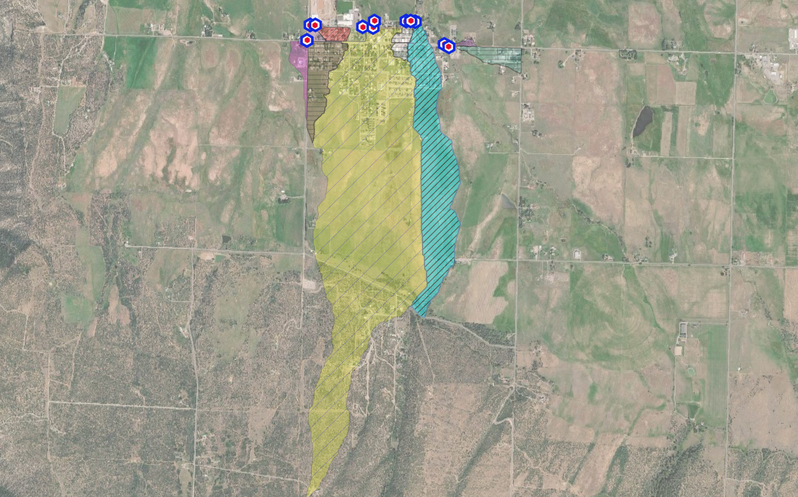
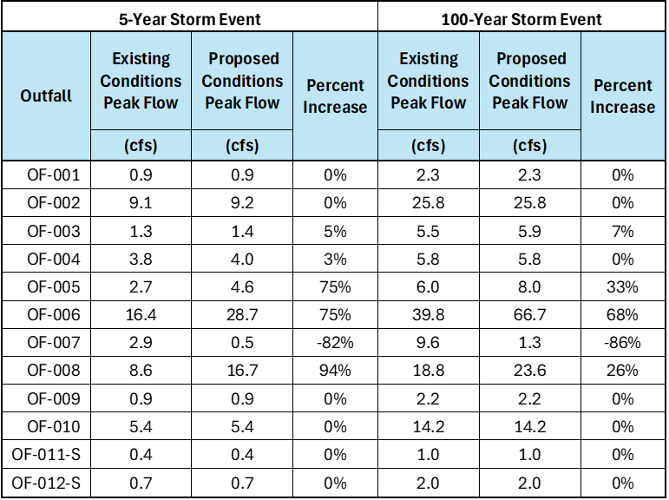
Drainage Area and Subbasins
OF-006
OF-007
OF-008
Outfall Location Descriptions
OF-001 Aspen & Z42W
OF-002 Aspen & Z42E
OF-003 HWY 145 & Summit
OF-004 Summit to County Fairgrounds
OF-005 Summit East of High School
OF-006 Summit & Cedar
OF-007 North of Summit
OF-008 Market North of Summit
OF-009 Gurley Ditch North of Grand
OF-010 Gurley Ditch South of Grand
OF-011-S B/W OF-007 and OF-008
OF-012-S North and East of OF-006
636 acres drain through Town — only 225 (35%) are inside Town limits
The 451-acre OF-006 basin drains the Cedar & Spruce system – 71% of drainage area
Lucerne and Market (OF-007 & OF-008) ~120 acres (19%)
Flows rise at OF-006 and OF-008 because runoff reaches the outfalls
Notes:
Total of 636 Acres with 225 Acres in Town Limits

Slide 5
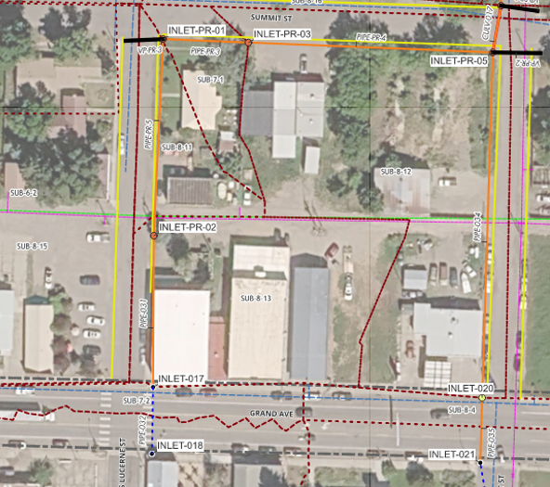
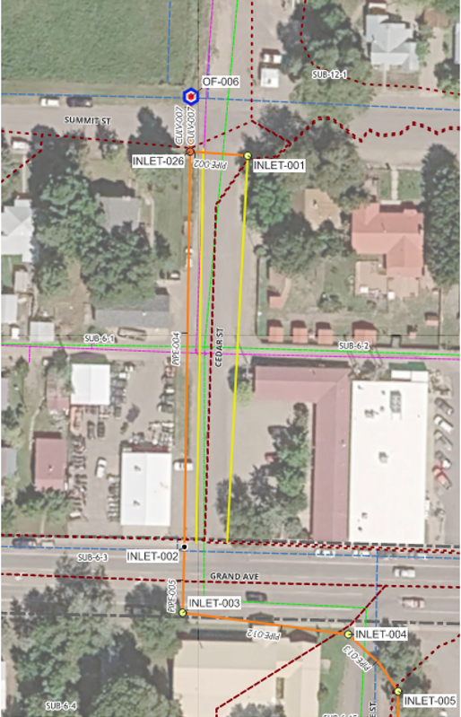
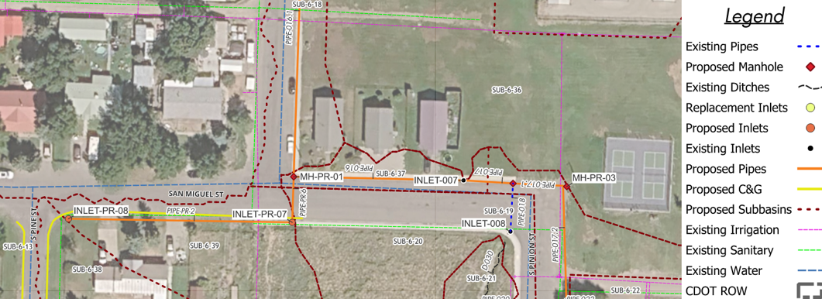
Cedar
[$525K]
Lucerne and Market
[$1.8M]
Pine and San Miguel
[$1.2M]
Note: Town Staff completed emergency improvements along Cedar Street in Summer of 2026
Focus Improvement Areas
Notes:
The following are presented as planning-level budgets and not construction bids
Cedar
Improvements
Pipe the existing open ditch along the west side of Cedar Street
Add curb and gutter to improve runoff collection and routing
Install an irrigation diversion structure
Upsize existing pipes
Install new storm drain inlets on the south side of the Summit Street intersection
Complete Downstream Improvements First
Budget - $525K
Lucerne and Market
Improvements:
Install five storm drain inlets on Lucerne, Summit, and Market streets
Add curb and gutter
Install a piped system from Lucerne Street
Bypass the historic drainage pathway adjacent to the fire protection district building
Convey flow east along Summit Street into the Market Street system
Add valley pans at Summit Street and Market Street.
Prioritize downstream improvements to increase capacity
Budget - $1.8M
South Pine and San Miguel
Improvements:
Add curb and gutter along South Pine Street and connecting portions of San Miguel Street
Install inlet improvements at South Pine/San Miguel
Pipe stormwater east from the proposed inlet
Install a second inlet or junction structure to route flow north into the existing South Pine storm network.
Includes riprap ditch improvements along Pinion adjacent to the library.
Note: This budget includes all work to the south and east of INLET-003 on the south side of Grand Avenue at Cedar Street south to Paradox and Includes Improvements along South Pine (Paving, Curb and Gutter, and Inlets).
Prioritize downstream improvements/conveyance agreement
Budget - $1.2M
Key dependency for all projects:
Acceptance of flows by downstream property owner(s) (written agreement)
Complete final survey and engineering before advancing additional improvements

Slide 6
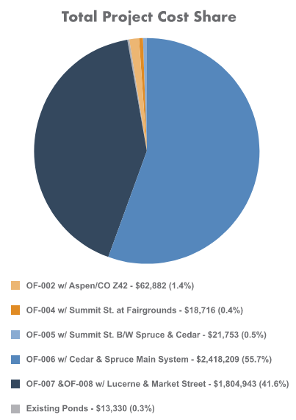
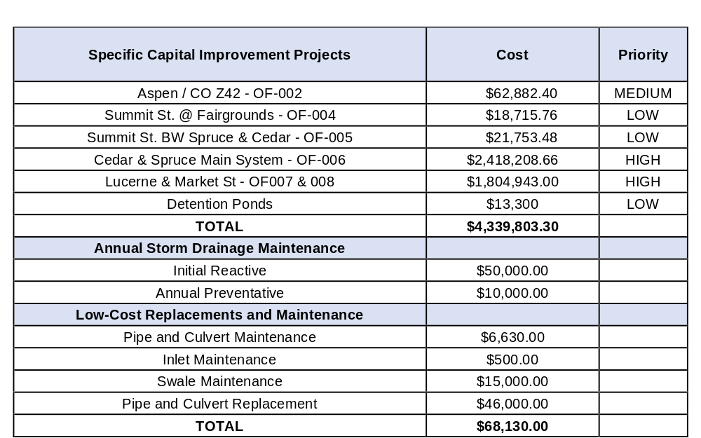
Budgetary Estimate
$4.3M total need (2026 dollars) — two HIGH systems are 97% of it
$63K of medium priority improvements (Culvert Replacement)
$50K of upfront maintenance - $10K after functioning
$68K of low-cost replacements, maintenance, and improvements that can start now
Notes:
Anticipated budget in 2026 dollars.
Costs include- Engineering and design services
$50,000 initial reactive maintenance
$10,000 estimated annual preventive maintenance after the backlog is addressed
$68,130 in separately identified low-cost replacements and maintenance, per Table 8-5

Slide 7
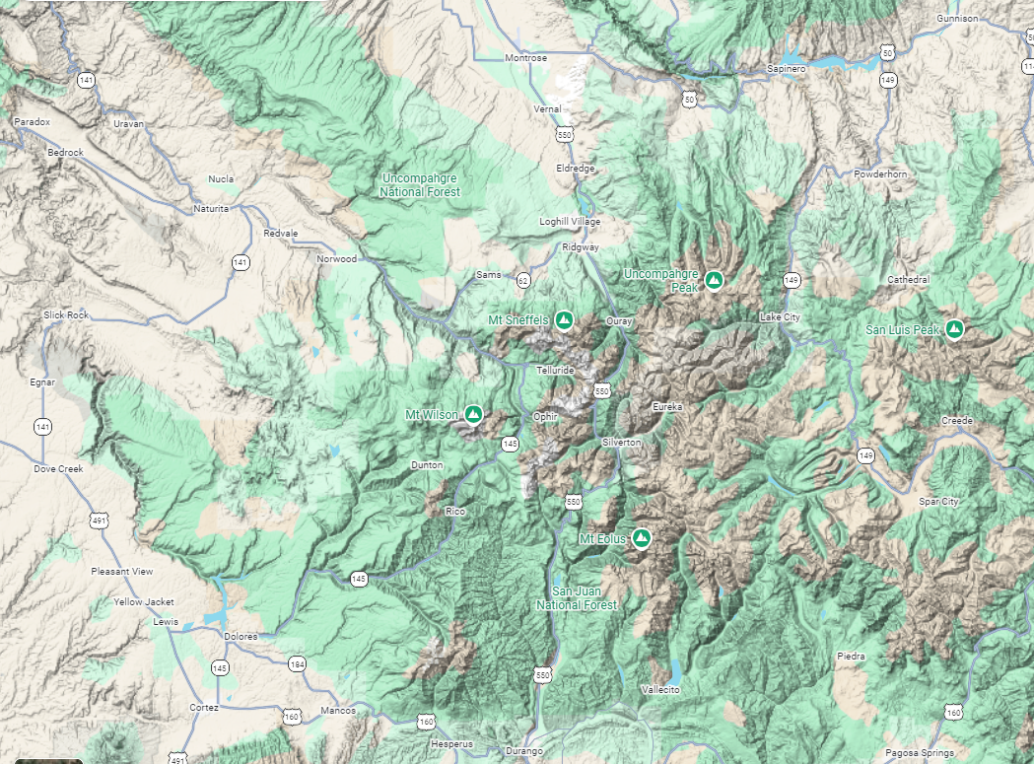
Key Takeaways & Next Steps
The plan addresses flooding concerns at homes, the fire station, and Town streets.
Cedar and Market are the Town’s two primary drainage systems.
The capital program totals $4.34 million in 2026 dollars. Two high-priority systems account for 97% of the cost.
The plan identifies $68,000 in near-term maintenance and replacements.
Downstream capacity improvements should precede upstream work.
Proposed next steps: confirm priorities and initial maintenance, then assess design needs, conveyance agreements, and funding options.
Notes:
Town of Norwood Master Drainage Plan
Proposed Presentation Outline

Slide 8
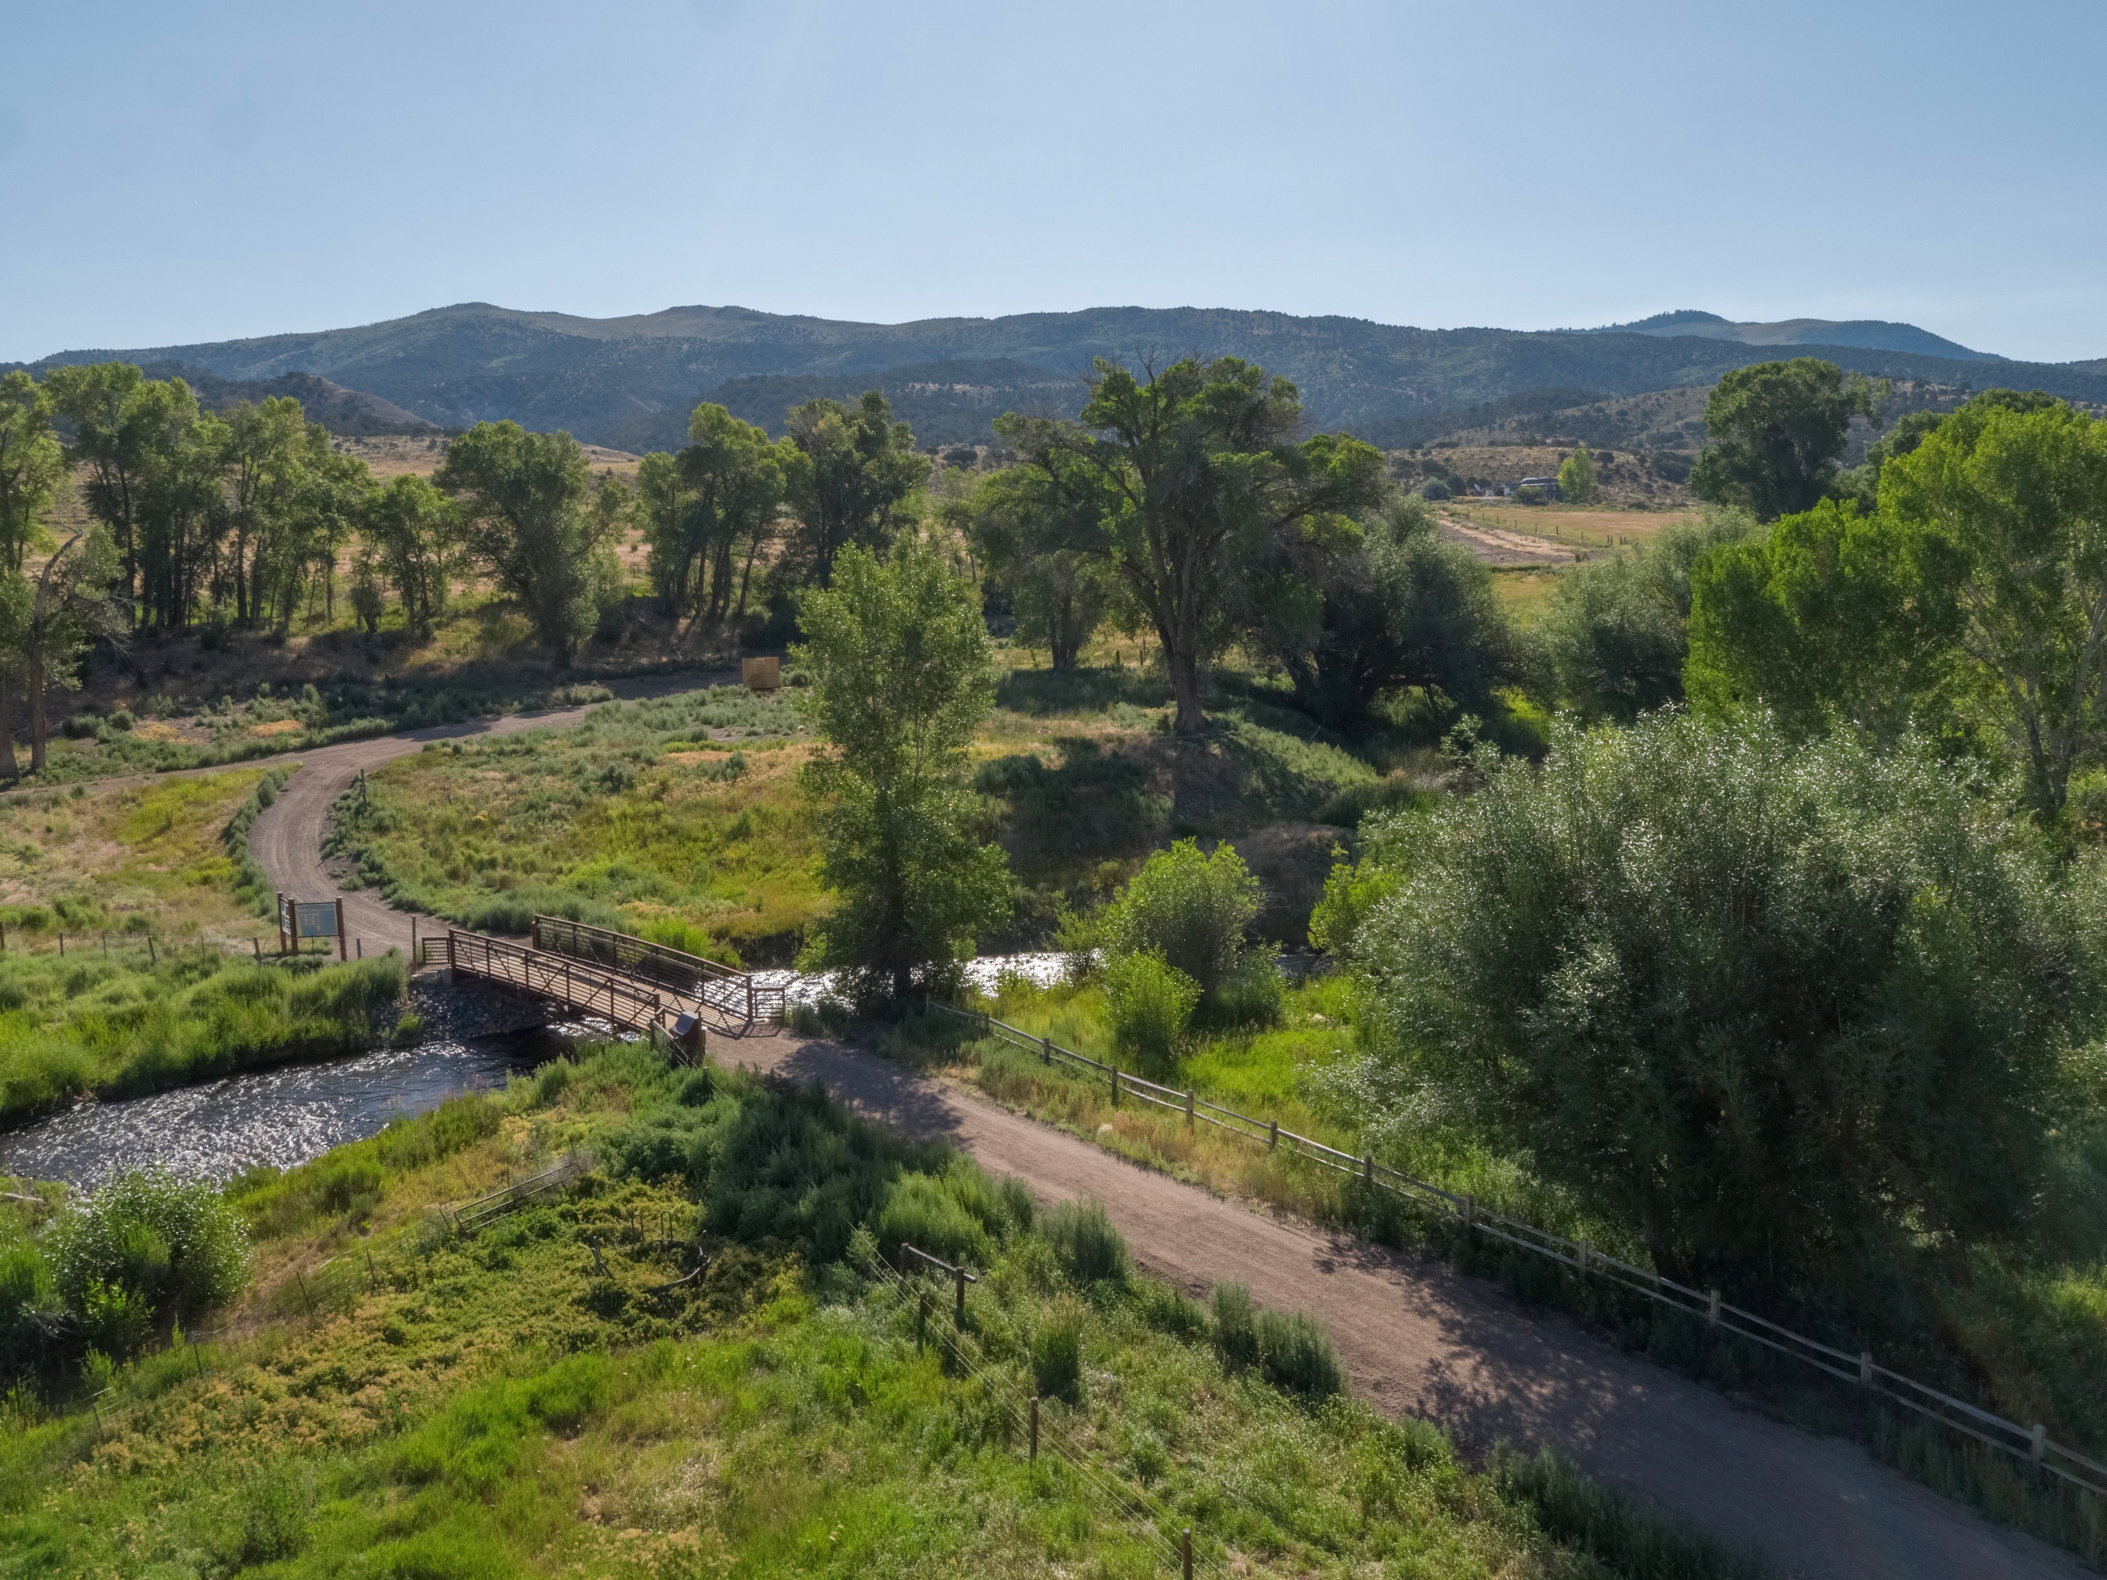
Questions?
Notes:
Which projects should be prioritized?
What maintenance can the Town authorize now?
What additional design or agreements are needed before construction?
What does the preliminary timeline for funding options and implementation proposal look like?

